Slide 1
Update In The Treatment Of BRAF Mutated Colo-Rectal Cancer
Dr Malek Alhamidi
Dec 5, 2019

Slide 2
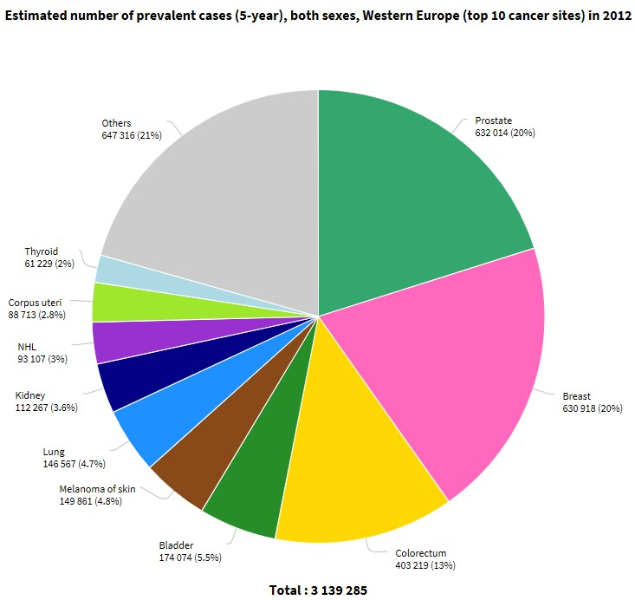
CRC Epidemiology – European Union
Incidence:
Mortality:
•
345,000 cases (2012)¹
152,000 deaths (2012)¹
₂nd
and 3rd most common tumor (m/f) in
Western Europe (Incidence/Mortality 2012):¹
− Men: 193,000 / 83,000
− Women: 152,000 / 69,000
5-year prevalence in 2012:
Worldwide 11%, Western Europe 13%¹
30–50% of patients with CRC relapse and most of them die from their disease.²
Clinical outcomes in mCRC improved³:
mOS in phase III trials & large observationals
∼30 months
1 – Cancer Today: http://gco.iarc.fr/today/home, last accessed 15-June-2018; 2 – ESMO Guidelines on Early Colon Cancer: Labianca
R et al., Ann Oncol 2013;24(Suppl 6):vi64-vi72; 3 – ESMO Guidelines on mCRC: van Cutsem E, et al., Ann Oncol 2016;27:1386-1422.
Medical Training CRC & BEACON | Version 0.2 | August 2018 | CONFIDENTIAL – For internal use only

Slide 3
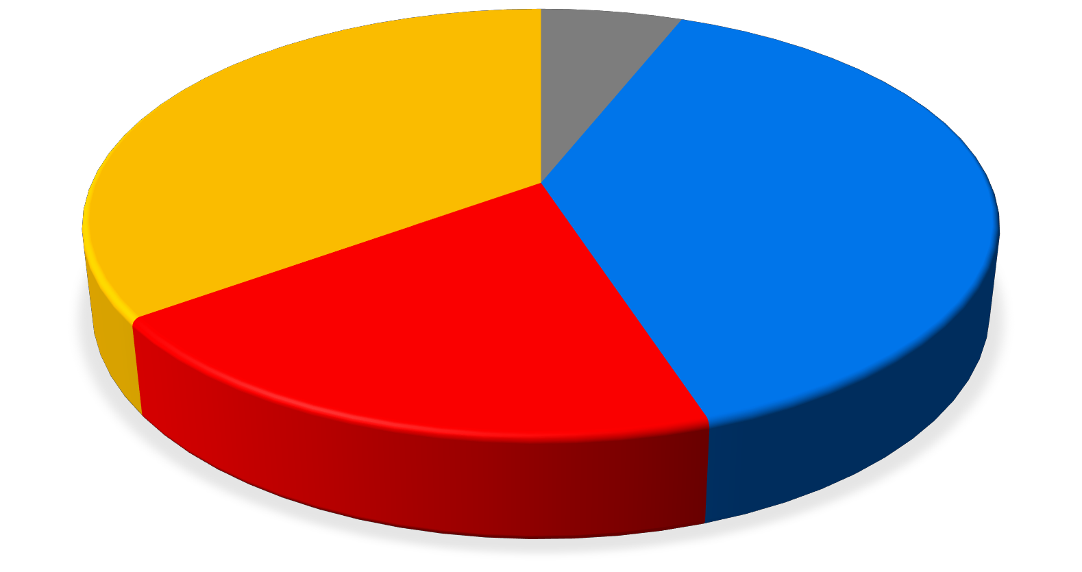
CRC Stages at Diagnosis¹
Unknown (unstaged) 6%
Regional (spread to regional lymph nodes) 35%
Localized (confined to primary site) 39%
Distant (metastatic) 20%
Similar data were recorded in the UK ²
1 Adapted from American Cancer Society colorectal-cancer-facts-and-figures-2017-2019 ² Cancer Research UK Bowel cancer incidence statistics available at : https://www.cancerresearchuk.org/health-professional/cancer-statistics/statistics-by-cancer- type/bowel-cancer/incidence
Medical Training CRC & BEACON | Version 0.2 | August 2018 | CONFIDENTIAL – For internal use only

Slide 4
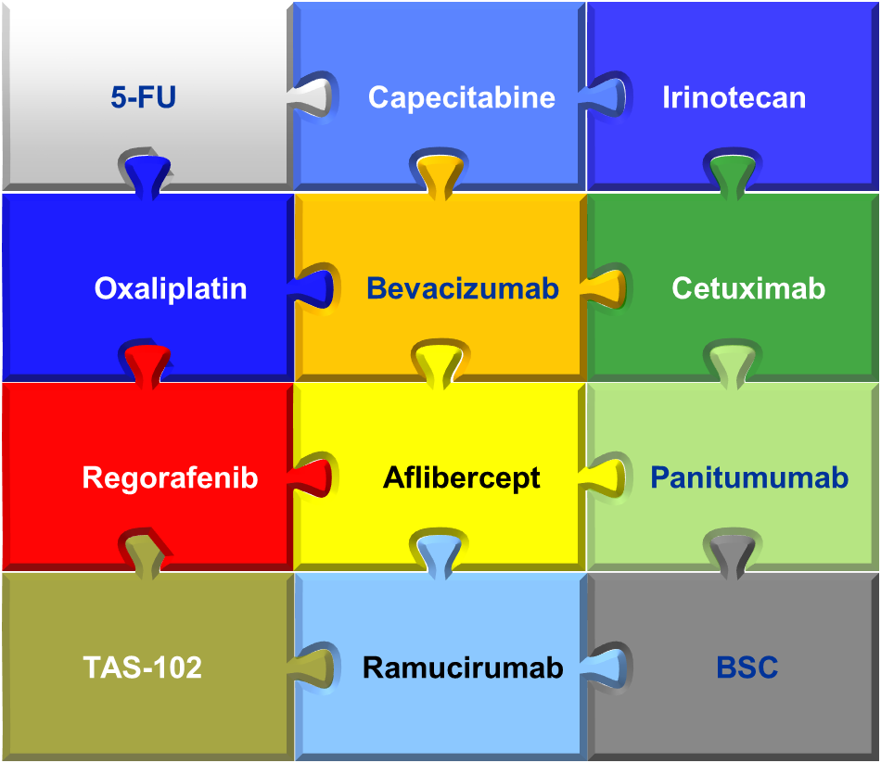
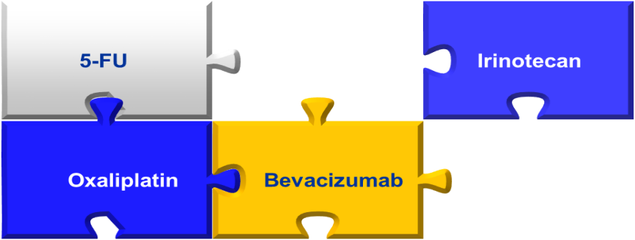
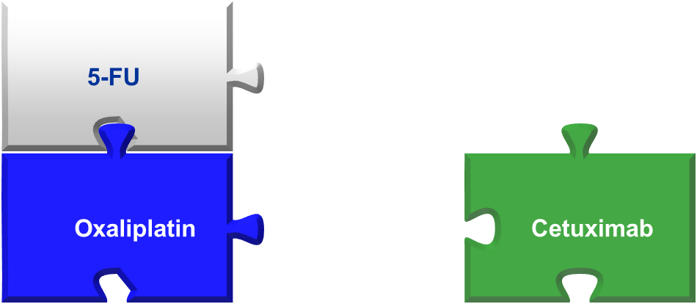
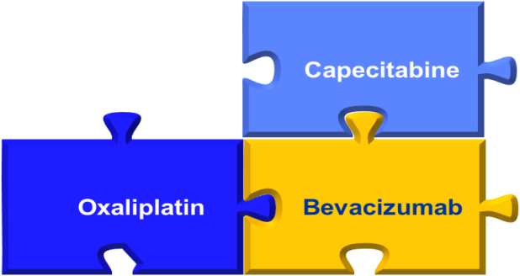
The Luxury of So Many Options: How Do We Personalize Therapy?
5-FU
Irinotecan
Patient X
Oxaliplatin
Bevacizumab
5-FU
Patient Y
Oxaliplatin
Cetuximab
Capecitabine
Patient Z
Oxaliplatin
Bevacizumab
Notes:
5-FU, 5-fluorouracil; BSC, best supportive care.

Slide 5
Proportional Impact on Magnitude of OS Benefit Achieved Across Lines of Therapy
Median OS
Improvement, Mos
1 L
FOLFIRI ± cetuximab^{[1]}
0.8
3.5*
Not for RAS Mut
FOLFOX4 ± panitumumab^{[2]}
0.83
4.2†
FOLFOX/XELOX ± bevacizumab^{[3]}
0.89
1.4
2 L
FOLFOX ± bevacizumab^{[4]}
0.75
2.1
FOLFIRI ± panitumumab^{[5]}
Not for RAS Mut
0.85
2.0 †
FOLFIRI ± ramucirumab^{[6]}
0.84
1.6
CT ± continued bevacizumab^{[7]}
0.81
1.4
FOLFIRI ± aflibercept^{[8]}
0.82
1.4
3/4 L
Regorafenib vs placebo^{[9]}
0.77
1.4
TAS-102 vs placebo^{[10]}
0.68
1.8
*KRAS WT subset; P = significant.
†KRAS WT subset; P = not significant.
0
0.2
0.4
0.6
0.8
1.0
HR for OS
References in slidenotes.
Notes:
CT, chemotherapy; FOLFIRI, fluorouracil/leucovorin/irinotecan; FOLFOX, fluorouracil/leucovorin/oxaliplatin; MT, mutation; WT, wild type; XELOX, capecitabine/oxaliplatin.
References:
1. Van Cutsem E, et al. J Clin Oncol. 2011;29:2011-2019.
2. Douillard JY, et al. J Clin Oncol. 2010;28:4697-4705.
3. Saltz LB, et al. J Clin Oncol. 2008;26:2013-2019.
4. Giantonio BJ, et al. J Clin Oncol. 2007;25:1539-1544.
5. Peeters M, et al. J Clin Oncol . 2010;28:4706-4713.
6. Tabernero J, et al. Lancet Oncol. 2015;16:499-508.J
7. Bennouna J, et al. Lancet Oncol. 2013;14:29-37.
8. Van Cutsem E, et al. J Clin Oncol. 2012;30:3499-3506.
9. Grothey A, et al. Lancet. 2013;381:303-312.
10. Mayer RJ, et al. N Engl J Med. 2015;372:1909-1919.

Slide 6
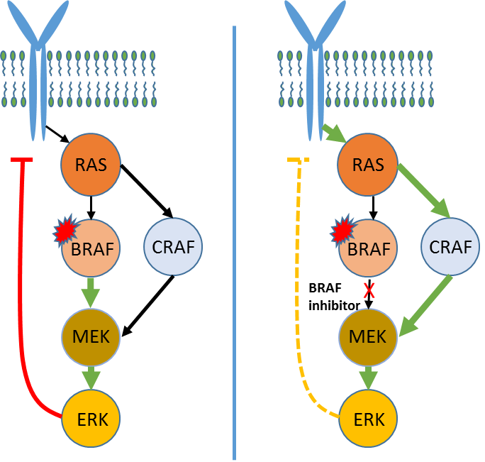
BRAFV600E mutation in mCRC
Occurs in 10%–15% of patients and confers a poor prognosis^{1,2}
Standard therapies have limited benefits after ≥1 line of treatment:
  Median OS 4–6 mo, median PFS ~2 mo and ORR <10%^{1,3-5}
  SWOG S1406 results with vemurafenib, irinotecan, cetuximab (VIC): Median OS of 9.6 mo, median PFS of 4.3 mo, and ORR in 16% (confirmed + unconfirmed)⁶
BRAF inhibitors cause feedback activation of EGFR in BRAF-mutant CRC, leading to continued cell proliferation^{7,8}
  Feedback may be overcome by targeting multiple nodes in the pathway
Updated mature phase 2 results with doublet of ENCO + CETUX*: Median OS of 9.3 mo, median PFS of 4.2 mo and ORR in 24%⁹
MAPK Signaling in Colorectal Cancer¹⁰
* Data cut-off January 2018; last patient enrolled 14 April 2015. Full updated data to be presented at future meeting.
CETUX=cetuximab; EGFR=epidermal growth factor receptor; ENCO=encorafenib; MAPK=mitogen-activated protein kinase; mCRC=metastatic colorectal cancer; PFS=progression-free survival; ORR=objective response rate; OS=overall survival; VIC=vemurafenib + irinotecan + cetuximab.
1. Loupakis F, et al. Br J Cancer. 2009;101:715. 2. Tie J, et al. Int J Cancer. 2011;128:2075. 3. De Roock W, et al. Lancet Oncol. 2010;11(8):753. 4. Mitani S, et al. Ann Oncol. 2017;28(5s). 5. Ulivi P, et al. J Transl Med. 2012;10:87. 6. Kopetz S, et al. J Clin Oncol. 2017;35(15):3505. 7. Corcoran RB, et al. Cancer Disc. 2012;2(3):227. 8. Prahallad A, et al. Nature 2012;100:100. 9. Tabernero J, et al. J Clin Oncol. 2016;34:3544. 10. Adapted From: Strickler JH. Cancer Treatment Reviews. 2017; 60:109.

Slide 7
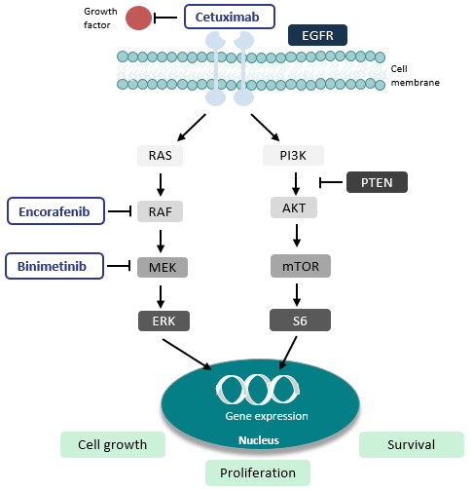
Rationale for triple combination in BRAF-mutant mCRC
MAPK Signaling in Colorectal Cancer¹
Pharmacodynamic data suggest that BRAF/MEK inhibitors do not inhibit the MAPK kinase pathway in colorectal cancer to the level seen in melanoma^{2,3}
BRAF-mutant colorectal cancer cells display high basal levels of several phosphorylated RTKs, including EGFR, compared to BRAF-mutant melanoma⁴
Mechanistically, BRAF^{V600E} inhibitors have shown to cause a rapid feedback activation of EGFR in BRAF-mutant colorectal cancer, which supports continued proliferation in the presence of BRAF^{V600E} inhibition^{2,4}
The combination of BRAF + MEK + EGFR inhibitor combinations may suppress MAPK pathway signaling and have a therapeutic benefit in this population^{2-3,5}
  Adapted From: Dasari A, Messersmith WA. Clin Cancer Res. 2010 August 1;16(15):3811-8.
  Prahallad A, et al. Nature. 2012;483;100-103.
  Corcoran RB, et al. Presented at: European Society for Medical Oncology; Copenhagen, Denmark, October 9, 2016.
  Corcoran RB, et al. Cancer Discov. 2012 March;2(3):227-235.
  Atreya CE, et al. J Clin Oncol 33, no.15_suppl May 2015;103-103 (3).
PFS=progression free survival; ORR=objective response rate; OS=overall survival; mCRC=metastatic colorectal cancer; MAPK=Mitogen-activated protein kinase; EGFR=epidermal growth factor receptor; RTK=receptor tyrosine kinase

Slide 9
Encorafenib + Cetuximab ± Binimetinib for BRAF V600E–Mutant mCRC (BEACON CRC): Phase III Study Design
A multicenter, randomized, open-label, 3-arm phase III trial
Primary endpoints: OS and ORR for triplet vs control
Secondary endpoints: OS and ORR for doublet vs control, triplet vs doublet; PFS; safety
Binimetinib 45 mg BID
Encorafenib 300 mg QD
Cetuximab 400 mg/m² → 250 mg/m² QW
(n = 205)
Patients with BRAF V600E+ mCRC with PD after 1-2 prior regimens (no prior RAF/MEK/EGFR inhibitors);
no symptomatic brain mets
Safety Lead-in
Binimetinib 45 mg BID
Encorafenib 300 mg QD
Cetuximab 400 mg/m² → 250 mg/m² QW
Encorafenib 300 mg QD
Cetuximab 400 mg/m² → 250 mg/m² QW
(n = 205)
Patients followed for OS beyond progression
Investigator’s Choice
FOLFIRI/Cetuximab or
Irinotecan/Cetuximab
(n = 205)
N = 30
Van Cutsem. JCO. 2019;[Epub]. Taberno. ESMO 2019. LBA32. Kopetz. NEJM. 2019;[Epub]. NCT02928224
Notes:
AE, mCRC, metastatic colorectal cancer; mets, metastases; PD, progressive disease.

Slide 10
BEACON CRC: Baseline Characteristics
Characteristic | Triplet Regimen (n = 224) | Doublet Regimen (n = 220) | Control (n = 221)
Median age, yrs (range) | 62 (26-85) | 61 (30-91) | 60 (27-91)
Male, n (%) | 105 (47) | 115 (52) | 94 (43)
ECOG: 0/1/2, n (%) | 116 (52)/108 (48)/0 | 112 (51)/104 (47)/4 (2) | 108 (49)/113 (51)/0
Location of primary tumor, n (%) Left side of colon, including rectum Right side of colon Both sides or unknown | 79 (35) 126 (56) 19 (8) | 83 (38) 110 (50) 27 (12) | 68 (31) 119 (54) 34 (15)
Involvement of ≥ 3 organs, n (%) | 110 (49) | 103 (47) | 98 (44)
Presence of liver metastases, n (%) | 144 (64) | 134 (61) | 128 (58)
Primary tumor removed, n (%) Completely resected Partially resected or unresected | 133 (59) 91 (41) | 123 (56) 97 (44) | 122 (55) 99 (45)
Previous lines of therapy: 1/2, n (%) | 146 (65)/78 (35) | 146 (66)/74 (34) | 145 (66)/76 (34)
Microsatellite instability-high, n (%) | 22 (10) | 19 (9) | 12 (5)
Baseline CEA > 5 μg/L, n (%) | 179 (80) | 153 (70) | 178 (81)
Baseline C-reactive protein > 10 mg/L, n (%) | 95 (42) | 79 (36) | 90 (41)
Taberno. ESMO 2019. LBA32. Kopetz. NEJM. 2019;[Epub].
Notes:
ECOG, Eastern Cooperative Oncology Group.

Slide 11
BEACON CRC: Univariate Analysis of Baseline Characteristics
Baseline Variables Indicative of Poor Prognosis Regardless of Treatment Arm | HR (P Value)
CRP > 10 mg/L | 3.13 (< .0001)
Presence of liver metastases | 2.60 (< .0001)
CEA > 5 ug/L | 2.56 (< .0001)
CA 19.9 > 35 U/mL | 1.96 (< .0001)
≥ 3 organs involved | 1.61 (< .0001)
≥ 2 prior regimens for metastatic disease | 1.27 (.0493)
Univariate Cox-regression for OS of baseline variables (all phase III patients)
Poor prognosis variables all occurred with numerically higher frequency in triplet vs doublet arm
Taberno. ESMO 2019. LBA32. Kopetz. NEJM. 2019;[Epub].

Slide 12
BEACON CRC: OS and ORR
Triplet vs Control (Primary Endpoint)
Doublet vs Control
100
100
80
Triplet
Median OS, Mos (95% CI)
9.0 (8.0-11.4)
5.4 (4.8-6.6)
80
Doublet
Median OS, Mos (95% CI)
8.4 (7.5-11.0)
5.4 (4.8-6.6)
Triplet
Control
Doublet
Control
60
60
OS (%)
Control
OS (%)
40
40
Control
20
20
HR: 0.52 (95% CI: 0.39-0.70; P < .0001)
HR: 0.60 (95% CI: 0.45-0.79; P = .0003)
0
0
0
2
4
6
8
10
12
14
16
18
20
22
0
2
4
6
8
10
12
14
16
18
20
22
Mos Since Randomization
Mos Since Randomization
Triplet
Control
224
221
186
158
141
102
103
60
69
34
37
18
24
15
14
7
6
4
4
2
2
1
0
0
Doublet
Control
220
221
184
158
133
102
87
60
57
34
33
18
21
15
12
7
8
4
3
2
1
1
0
0
Confirmed Response by BICR | Triplet Regimen (n = 111) | Doublet Regimen (n = 113) | Control (n = 107)
ORR, % (95% CI) | 26 (18-35) | 20 (13-29) | 2 (< 1-7)
P value (vs control) | < .0001 | < .0001
Taberno. ESMO 2019. LBA32. Kopetz. NEJM. 2019;[Epub].
Notes:
BICR, blinded independent central review.

Slide 13
BEACON CRC: PFS (BICR)
Triplet vs Control (Primary Endpoint)
Doublet vs Control
100
Median PFS, Mos (95% CI)
4.3 (4.1-5.2)
1.5 (1.5-1.7)
100
Median PFS, Mos (95% CI)
4.2 (3.7-5.4)
1.5 (1.5-1.7)
90
Triplet
Control
90
Doublet
Control
80
80
70
HR: 0.38 (95% CI: 0.29-0.49;
P < .0001)
70
HR: 0.40 (95% CI: 0.31-0.52;
P < .0001)
60
Triplet
60
Doublet
PFS (%)
PFS (%)
50
50
40
40
30
30
20
Control
20
Control
10
10
0
0
0
2
4
6
8
10
12
14
16
18
20
0
2
4
6
8
10
12
14
16
18
20
Mos
Mos
Triplet | 224 | 141 | 90 | 30 | 22 | 11 | 5 | 2 | 2 | 1 | 0
Control | 221 | 50 | 26 | 9 | 6 | 2 | 0 | 0 | 0 | 0 | 0
Doublet | 220 | 143 | 80 | 37 | 27 | 12 | 4 | 2 | 2 | 1 | 0
Control | 221 | 50 | 26 | 9 | 6 | 2 | 0 | 0 | 0 | 0 | 0
Taberno. ESMO 2019. LBA32. Kopetz. NEJM. 2019;[Epub].
Notes:
BICR, blinded independent central review.

Slide 14
BEACON CRC: OS Multivariate Regression
Prespecified analysis in all randomized patients
Additional baseline variables with no significance in multivariate regression included gender, age, removal of primary tumor, number of organs involved, number of prior regimens for metastatic disease and prior use of oxaliplatin
CEA and CA-19.9 not included in the prespecified analysis
Triplet vs Doublet | HR
Treatment effect | 0.75 (95% CI: 0.55-1.03)
Statistically significant baseline variables:
Right vs left side tumor | 1.92 (P = .0004)
Presence of liver metastases | 2.35 (P < .0001)
CRP baseline value > 10 mg/L | 3.13 (P < .0001)
Taberno. ESMO 2019. LBA32. Kopetz. NEJM. 2019;[Epub].

Slide 15
BEACON CRC: AEs
AEs in ≥ 15% of Patients in Any Arm, n (%) | Triplet Regimen (n = 224) |  | Doublet Regimen (n = 216) |  | Control (n = 193)
 | Any Grade | Grade ≥ 3 | Any Grade | Grade ≥ 3 | Any Grade | Grade ≥ 3
Any AE | 217 (98) | 128 (58) | 212 (98) | 108 (50) | 188 (97) | 117 (61)
Diarrhea | 137 (62) | 22 (10) | 72 (33) | 4 (2) | 93 (48) | 19 (10)
Acneiform dermatitis | 108 (49) | 5 (2) | 63 (29) | 1 (< 1) | 76 (49) | 5 (3)
Nausea | 100 (45) | 10 (5) | 74 (34) | 1 (< 1) | 80 (41) | 2 (1)
Vomiting | 85 (38) | 9 (4) | 46 (21) | 3 (1) | 56 (29) | 5 (3)
Fatigue | 73 (33) | 5 (2) | 65 (30) | 9 (4) | 53 (27) | 8 (4)
Abdominal pain | 65 (28) | 13 (6) | 49 (23) | 5 (2) | 48 (25) | 9 (5)
Decreased appetite | 63 (28) | 4 (2) | 58 (27) | 3 (1) | 52 (27) | 6 (3)
Asthenia | 55 (25) | 7 (3) | 46 (21) | 7 (3) | 49 (25) | 9 (5)
Constipation | 55 (25) | 0 | 33 (15) | 0 | 35 (18) | 2 (1)
Dry skin | 46 (21) | 2 (1) | 24 (11) | 0 | 13 (7) | 1 (1)
Pyrexia | 45 (20) | 4 (2) | 35 (16) | 2 (1) | 27 (14) | 1 (1)
Rash | 42 (19) | 1 (< 1) | 25 (12) | 0 | 27 (14) | 3 (2)
Stomatitis | 31 (14) | 1 (< 1) | 12 (6) | 0 | 44 (23) | 4 (2)
Arthralgia | 23 (10) | 0 | 41 (19) | 2 (1) | 1 (1) | 0
Headache | 16 (7) | 0 | 42 (19) | 0 | 5 (3) | 0
Taberno. ESMO 2019. LBA32. Kopetz. NEJM. 2019;[Epub].
Notes:
AE, adverse event.
Headache, musculoskeletal pain, arthralgia, and myalgia occurred more frequently in the doublet-therapy group than in the triplet-therapy group but did not generally result in discontinuation of either component of the regimen. The less frequent occurrence of these adverse effects in the triplet-therapy group is consistent with the ability of MEK inhibition to mitigate some toxic effects associated with BRAF inhibition

Slide 16
BEACON CRC: Conclusions
In the phase III BEACON CRC trial, both the triplet regimen with encorafenib, binimetinib, and cetuximab and the doublet regimen with encorafenib and cetuximab led to significant improvement of OS and ORR vs standard of care in previously treated patients with BRAF V600E–mutant mCRC
  Median OS: 9.0 mos with triplet, 8.4 mos with doublet, 5.4 mos with control
  HR (OS) vs control: 0.52 with triplet; 0.60 with doublet
No new safety signals were observed
  Triplet mitigated toxicities associated with BRAF inhibitor (eg, arthralgia, headache)
Investigators conclude that results support combination treatment with BRAF/MEK/ EGFR inhibitors as new standard of care for patients with BRAF V600E–mutant mCRC
Taberno. ESMO 2019. LBA32. Kopetz. NEJM. 2019;[Epub].
Notes:
mCRC, metastatic colorectal cancer.

